Slide 1


PROJECT PRELIMINARY
(EE451)
SOLAR ENERGY MONITORING SYSTEM USING IoT
WITH AUTO AXIS CONTROL AND CLEANING
GUIDED BY
RIYA JOY
ASSISTANT PROFESSOR
EEE DEPARTMENT
VJEC
GUIDED BY
RAHUL P (VML16EE038)
SREEHARI P (VML16EE043)
SUMITH SUDHAKAR (VML16EE044)
SAHIL TOM (VML16EE040)
DEPARTMENT OF ELECTRICAL AND ELECTRONICS ENGINEERING
VIMAL JYOTHI ENGINEERING COLLEGE, CHEMPERI

Slide 2
CONTENTS
Introduction
Project Objective
Literature Survey
Proposed design
Disadvantage of existing system
Advantage of proposed design
Block diagram
Main hardware components
Working
Estimated Cost
Work plan
References
Conclusion

Slide 3
INTRODUCTION
Solar power has become a source of renewable energy and solar energy application should be enhanced.
About a million solar panels were installed every day around the world last year. Solar PV leads providing almost 40% of global renewable electricity capacity growth over the medium-term.
As the use of solar panel is increasing day by day it is necessary to implement a system to monitor the solar panel output
This system consist of 3 parts which are indented to solve 3 major issue on solar panel users

Slide 4
PROJECT OBJECTIVE
To Monitor and measure the output of solar panel wirelessly and remotely
To clean the solar panel automatically without much manpower and to move the solar panel on a single axis based on sunlight
Solar monitoring system can help make you more aware of your PV system’s performance. It offers information about generation and damage to your solar system. It’s important to monitor your solar setup in some manner – without monitoring, it can be difficult to figure out if your solar panels are operating at their best.

Slide 5
PROJECT OBJECTIVE
Solar panel has maximum output when the irradiation on it is maximum. Solar irradiation varies with position of sun.
So by tracking the position of maximum light intensity from sun, the irradiation can be maximized. This helps to utilize the solar panel to its maximum extent

Slide 6
LITERATURE SURVEY
“Development of Android based on-line monitoring and control system for Renewable Energy Sources” by Jiju K, Ramesh P, Brijesh P, Sreekumari B proposed an android based real time monitoring system for RES
the above system uses Bluetooth interface of Android Tablet/ Mobile phone as a communication link for data exchange which is not very speedy and also can be interrupted
Here we use raspberry pie to send data to a server which can be accesed from anywhere

Slide 7
LITERATURE SURVEY
“ The Development of Sun-Tracking System Using Image Processing”, by Cheng-Dar Lee *, Hong-Cheng Huang and Hong-Yih Yeh. Proposed a Solar tracking system which uses image processing to move the solar panel
The use of image processing technology require no of components and is also complex
Using LDR to control the axis is much simple and cheaper as it is based on which of the 2 LDR receives light energy

Slide 8
LITERATURE SURVEY
“Monitoring System for Solar Panel Using Smartphone Based on Microcontroller”, Rika Favoria Gusa, Irwan Dinata, Whari Sunanda,2018."
in the above given references they uses WIFI to transfer data which is Insecure and it cannot transfer over long distance
Currently we have a system which uses raspberry pi to transfer real-time data to the user
It is also cheap and efficient as compared to those mentioned above

Slide 9
PROPOSED DESIGN
In this design we are creating a solar panel monitoring system using IoT which can transmit data to a server
The design include automatic cleaning of pv panel along with tracking of sun

Slide 10
DISADVANTAGE OF EXISITNG SYSTEM
Existing solar PV output monitoring systems are expensive and is not much popular technology
The existing system are difficult use for normal users
Most of the current solar panels are not occupies with sun light tracking system and
Current solar panel cleaning systems are bulky and expensive

Slide 11
ADVANTAGE OF PROPOSED DESIGN
User can see the real-time output of the solar panel
User can clean the panel automatically
It has a sun tracking system , hence maximum efficiency and output
Low cost and easy to use
Does not require human intervention hence accurate and stored in web database

Slide 12
BLOCK DIAGRAM
Solar Energy Monitoring Using Iot
SOLAR PANEL
CURRENT AND VOLTAGE SENSOR
ARDUINO
RASPBERRY PI
SERVER
(THINKSPEAK)
CHARGE
CONTROLLER
USER
BATTERY
VOLTAGE REGULATOR

Slide 13
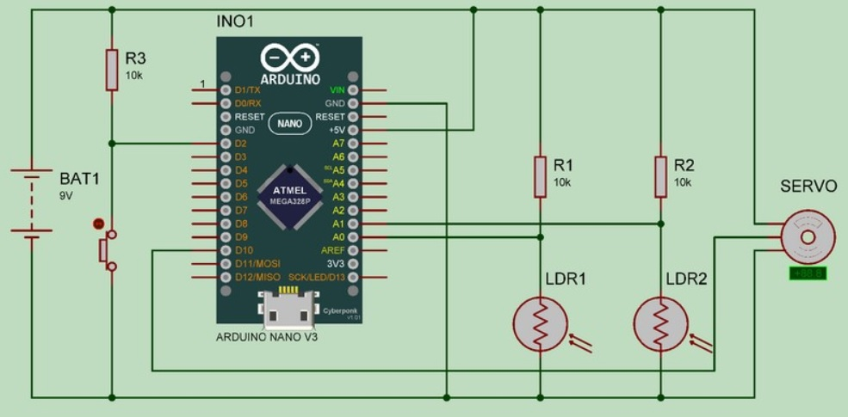
Automatic Axis Control

Slide 14
Cleaning Of Solar Panel
ULTRASONIC SENSOR
SERVO MOTOR
SOLAR PANEL
CHARGE CONTROLLER
ARDUINO
VOLTAGE REGULATOR
BATTERY
SWITCH

Slide 15
COMPONENTS
Arduino UNO 3
Raspberry Pi 3
Current Sensor - ACS712(30Amp)
Voltage Sensor
Resistors
3 DC motor
Roller Brush
LDR
LM7805 Voltage Controller
Relay

Slide 16
WORKING
The energy monitoring system works by sensing the current and voltage output of the solar panel and sending those values to Arduino
From Arduino the message signal is send to a raspberry pi
Raspberry pi is connected to internet programed to send
Rasberry pie send this Data to a server
The solar panel is mounted with 2 LDR sensors and the solar panel is connected to a bi directional motor
Based on the light recived by the LDR the panel is tilted by operating the motor using a motor driver
The motor driver consist of a dpdt relay which control the direction of rotation of motor

Slide 17
WORKING
The cleaning system works by moving a rotating brush over the panel using 2 dc motors mounted on a movable frame
One motor is connected to the brush and the other is connected to the frame to move it over the panel

Slide 18
Work Done Till Date
AUG-SEP | 2ND SEP | SEP-NOV | 2ND NOV
Topic Finalization | Zeroth Review | Literature Survey | First Review
Finalized project topic after discussing with guide and other staff members. | Presented the bare-bone idea for the project and received further instructions for modifications and improvement from evaluators. | Various papers published regarding this topic were looked into. Also presented this project for various funding competitions. | A finalized and detailed presentation based on the topic

Slide 19
Work Done Till Date
NOV- DEC | 1 JAN – JAN 20
Selection of Components | Collecting Data
Selection of panel and rating and other components, designing circuit | Various journals and online sites are analyzed.

Slide 20
Details Of Work Progress In The Current Semester
Design Calculation and selection of components
Circuit Designing
Survey

Slide 21
WORK PLAN
Key action step | Time line | Time Duration | Expected outcome
PHASE 1
Survey | Jan 20 – Jan 28 | 1 weeks | A survey is conducted among various types of solar panel monitoring systems
PHASE 2
Design of prototype. | Jan 28 – Feb15 | 2.5 weeks | Design of project including circuit diagram designing, component selection, etc.

Slide 22
WORK PLAN
PHASE 3
Component purchasing. | Feb 15– Feb 25 | 4-5 days | Purchasing of various components including raspberry pi ,solar panel, battery, etc.
PHASE 4
Software designing and verification | Feb 25 – March 15 | 2 weeks | Have to develop the python programming

Slide 23
WORK PLAN
PHASE 5
Hardware developing, verification and testing. | Mar 15 – Mar 24 | 3 weeks | Hardware developing, verification and testing.
PHASE 6
Documentation and report submission. | Mar 26 – Apr 10 | 1 week | Have to complete overall report of the project including total budget, reference, objectives and etc.

Slide 24
Expected Budget
Components | Cost
Solar panel and Battery | 3000
Raspberry pi 3 and Arduino UNO | 3000
Current Sensor - ACS712(30Amp) Voltage sensor (25 v) | 700
3 DC motor | 1500
PIC18F877A Controller | 1000
LM7805 voltage regulator ,LDR, tip120 transistor , DPDT RELAY, 2n3904 Transistor | 1000
Consumables | 3000
Travel and other expenses | 2000
TOTAL | 15,200/-

Slide 25
REFERENCES
Jiju K. et. al., 2014. "Development of Android based on-line monitoring and control system for Renewable Energy Sources." Computer, Communications, and Control Technology (I4CT), International Conference on. IEEE, 2014.
Rika Favoria Gusa, Irwan Dinata, Whari Sunanda,2018."Monitoring System for Solar Panel Using Smartphone Based on Microcontroller”, 2nd International Conference on Green Energy and Applications,2018
Cheng-Dar Lee, Hong-Cheng Huang and Hong-Yih Yeh, 2013. " The Development of Sun-Tracking System Using Image Processing.“, 2014

Slide 26
CONCLUSION
This system is a 3 in 1 solution for major problems faced by solar panel users and it is efficient and cheap compared to existing technologies

Slide 27


